Slide 1

Interfacing Temperature sensor and buzzer with Beaglebone Black
Submitted by:
Karamjot kaur (c0754576)

Slide 2
Agenda
Introduction
List of Components
Application in Project
Temperature Sensor
Buzzer
Connections in Schematic Diagram
Beaglebone Black and its pins used
Supporting Software
Connections
Results
Conclusions
References

Slide 3
Introduction
In this presentation, interfacing of temperature sensor and buzzer with beaglebone black has been explained.
Here, MLX90614 infrared temperature sensor and a buzzer is used.
The upcoming slides are going to explain the application of these components in project, its connections and the software used to complete this interfacing.

Slide 4
List of Components
Following components are used in this interfacing:
Temperature sensor (MLX90614)
Buzzer
Beaglebone Black
Breadboard
Jumper wires
External Power Adaptor

Slide 5
Application in the Project
In IoT based visitor counter project, temperature sensor is used to check the temperatures of the customers at the entrance of the store.
The maximum value of temperature has been set. If the customer has temperature more than the predefined value, then the entry will be denied.
This project has been designed by keeping the current government’s instructions about Covid-19 in mind.
Moreover, when a higher temperature is recorded, the buzzer will ring to indicate the other people present there about the higher temperature.

Slide 6
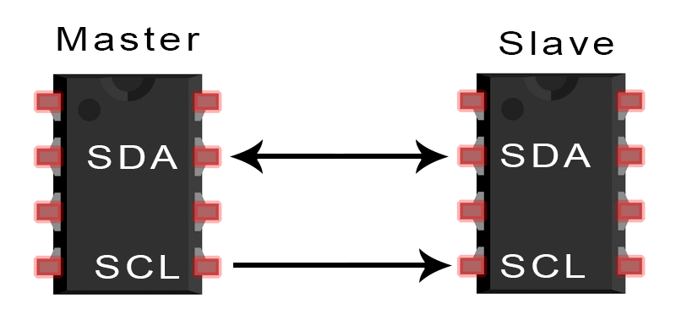
I2C protocol
I2C is a serial communication protocol.
In this protocol data is transferred bit by bit along a single wire (the SDA line).
Like SPI, I2C is synchronous, so the output of bits is synchronized to the sampling of bits by a clock signal shared between the master and the slave.
The clock signal is always controlled by the master.

Slide 7
Communication Protocol
In this project, I2C communication protocol is used between Beaglebone Black and MLX90614 temperature sensor.
I2cget command from Linux command line is used to read a data from i2c device.
Initially, the device address and the operation address needed to v found for the slave device from the data sheet.
Following command is used for the operation:
I2cget [-y] 0 <DEVICE ADDRESS> <ADDRESS> [MODE]
As:
char command1[30] = "i2cget -y 2 0x5a 0x07 w"

Slide 8
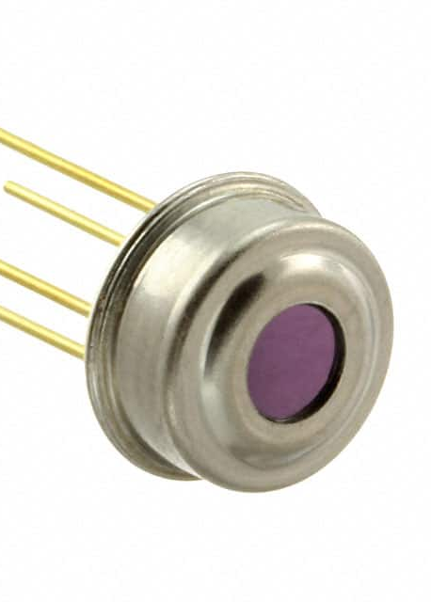
Temperature Sensor
In this project, MLX90614 sensor is used to check the temperature of customers at entrance.
It is an Infra Red thermometer for noncontact temperature measurements.
The measured temperature in range of -20…120 ˚C, with an output resolution of 0.14 ˚C.
The MLX90614 offers a standard accuracy of ±0.5ºC around room temperatures. A special version for medical applications exists offering an accuracy of ±0.1ºC in a limited temperature range around the human body temperature.

Slide 9
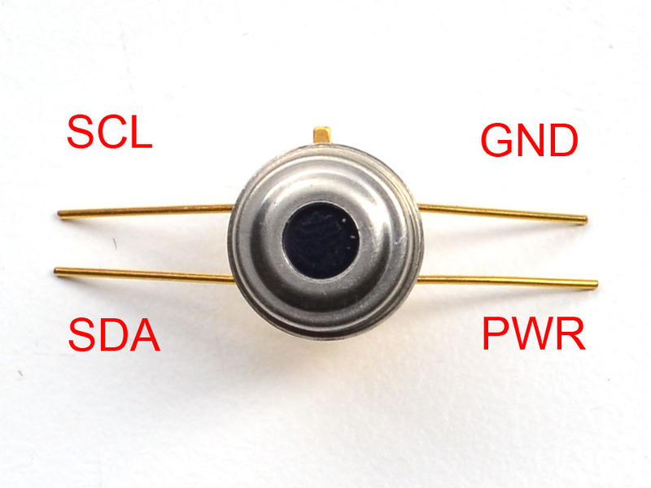
Temperature Sensor (conti.)
Pin | Description
GND (VSS) | Ground
PWR (VDD) | External voltage supply
SCL | Serial Clock input for 2 wires communication
SDA | Digital input/output pin and the measured temperature is available at this pin.

Slide 10
Features and Applications of Sensor
Feature:
Small size, low cost
Easy to integrate
High (medical) accuracy calibration
High accuracy of 0.5°C in a wide temperature range (0°C…+50°C for both Ta i.e. ambient temperature and To i.e. object temperature)
Available in 3V and 5V versions
Applications:
1. Body temperature measurement
2. High precision non-contact temperature measurements
3. Temperature sensing element for residential, commercial and industrial building air conditioning
4. Temperature control in printers and copiers
5. Body temperature measurement

Slide 11
Calculating Temperature
The result has a resolution of 0.02°C and is available in RAM. To is derived from RAM as:
To[°K] = Toreg × 02.0 , or 0.02°K / LSB.
Example: 1. 0x3AF7 28.75˚C (no error)
2. 0x3AF8 28.77˚C (no error)
The result is calculated by following expressions (valid for both To and Ta):
Convert a hexadecimal number to integer.
Convert an integer data into Celsius by using following formula:
float objTemp = (number1 * 0.0201) - 273.1

Slide 12
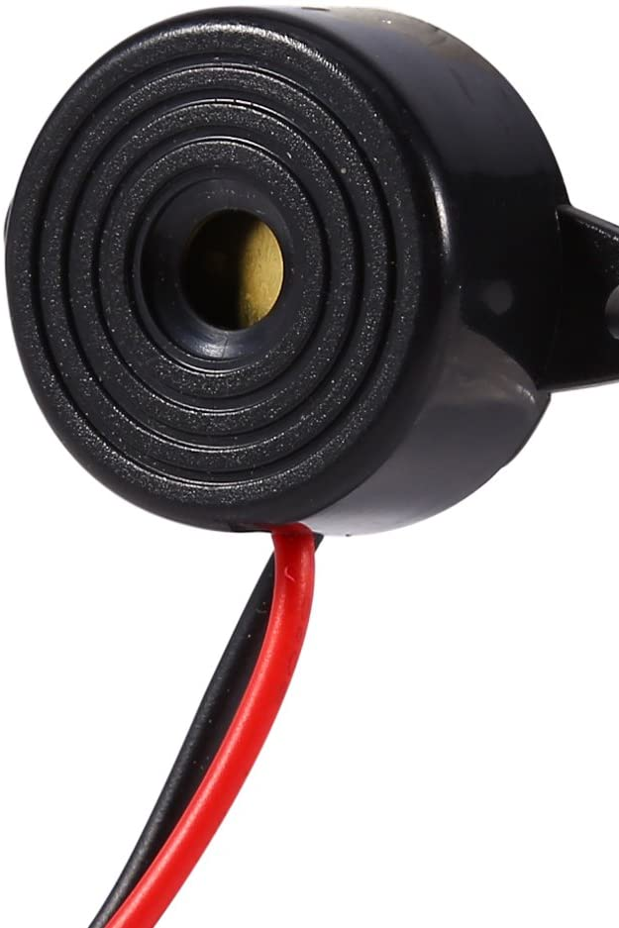
Buzzer
Piezo buzzer is a simple devices that can generate basic beeps and tones.
It works by using a piezo crystal, a special material that changes shape when voltage is applied to it.
If the crystal pushes against a diaphragm, like a tiny speaker cone, it can generate a pressure wave which the human ear picks up as sound.

Slide 13
Buzzer (conti.)
In this project, there is a digital communication between a buzzer and a Beaglebone Black using GPIO pins of Beaglebone Black.
Positive pins of buzzer is connected to the GPIO pin and negative is connected to the DGND of Beaglebone Black.
Initially, define the GPIO pin for buzzer and set it as an output pin.

Slide 14
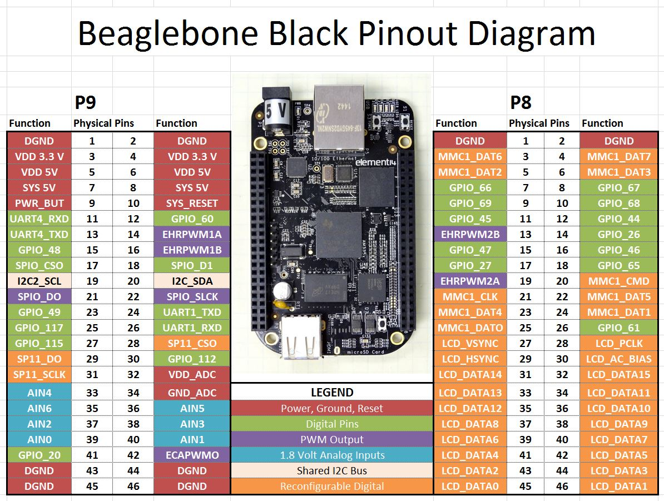
In this interfacing, pin 19 and 20 of port 9 are used for I2C communication.
For the power supply, pin 5 of port 9 is used for 5V supply.
Power supply for beaglebone black is given by external power adaptor.
Buzzer is connected to the GPIO pin 23 of port 9.
Ground is connected to pin 1 and pin 46 of port 9 for both temperature sensor and buzzer, respectively.

Slide 15
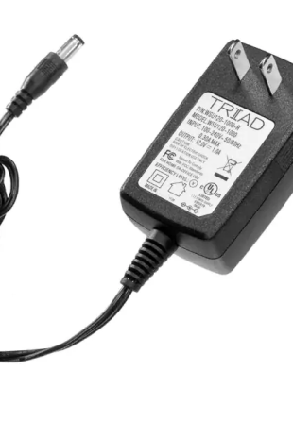
Power Adaptor
The power Adapter is used for the power supply of 5V to Beaglebone Black
Electrical specifications
Input voltage range – 90-264V
Output voltage – 5v
Average efficiency - >78.70%
Output current – 2A

Slide 16
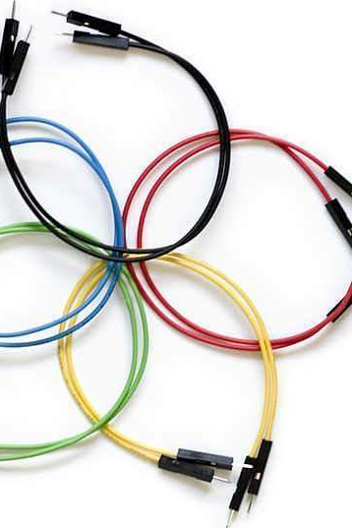
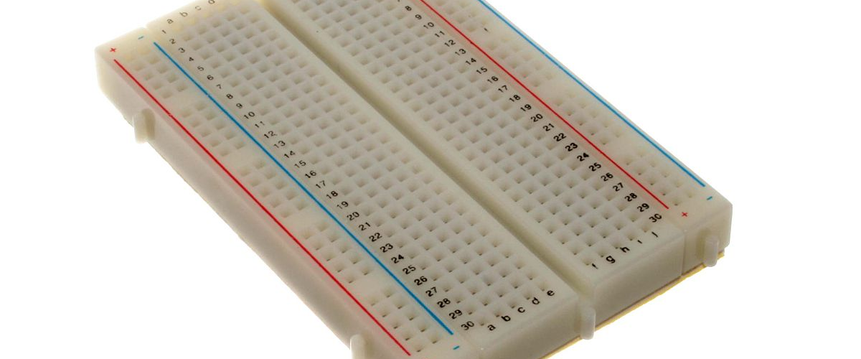
Jumper Wires and Breadboard
Breadboard and jumper wires are used to make connections between components and Beaglebone Black.

Slide 17
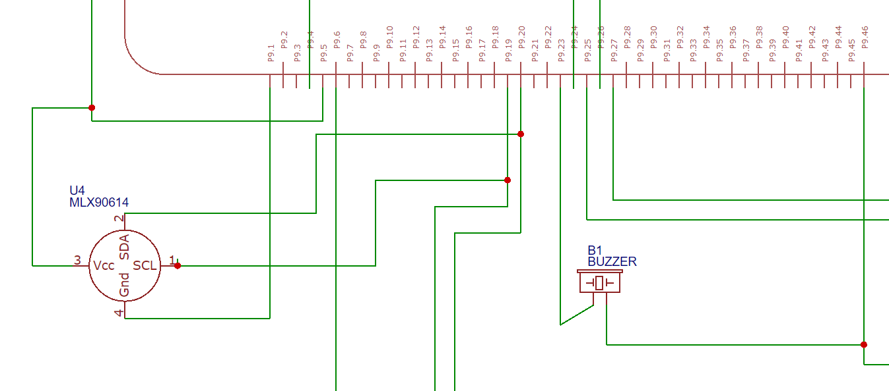
Connections in schematic diagram

Slide 18
Supporting Software
The programming of this interfacing is in C language. Here, Eclipse IDE is used to write the codes.
PuTTY is an SSH and telnet client, and it is an open-source software that is compatible with Microsoft Windows.
WinSCP (Windows Secure Copy) is a free and open-source SFTP, FTP, WebDAV, Amazon S3 and SCP client for Microsoft Windows. It is used for a secure file transfer between a local and a remote computer.
To define pins in BBB we need to install iobb library.
mkdir development
cd development
git clone https://github.com/shabaz123/iobb.git
cd iobb
Make
Make install

Slide 19
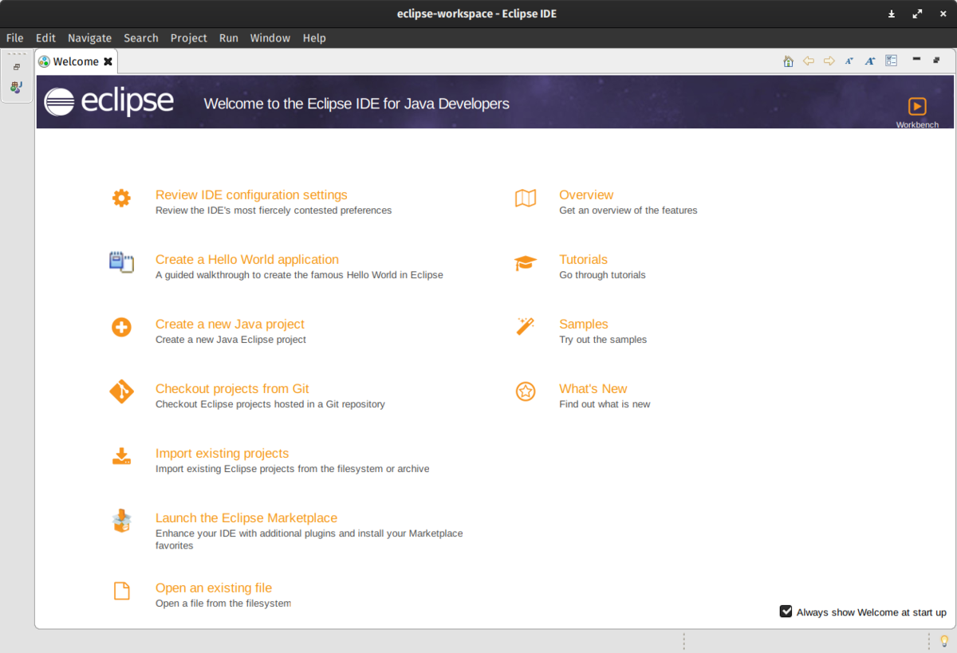

Slide 20
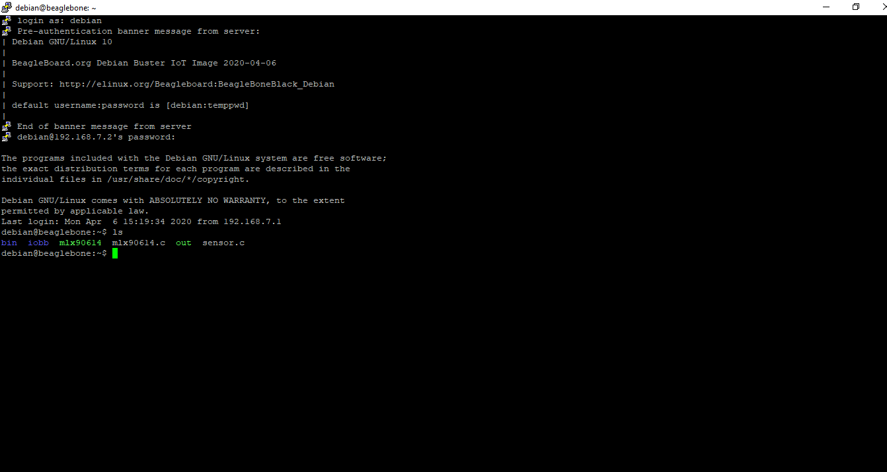
Here, IP address is used to open the portal. Then login as Debian and the password is temppwd.
After logging in “ls” commands is used to get the list of file stored in Beaglebone Black.

Slide 21
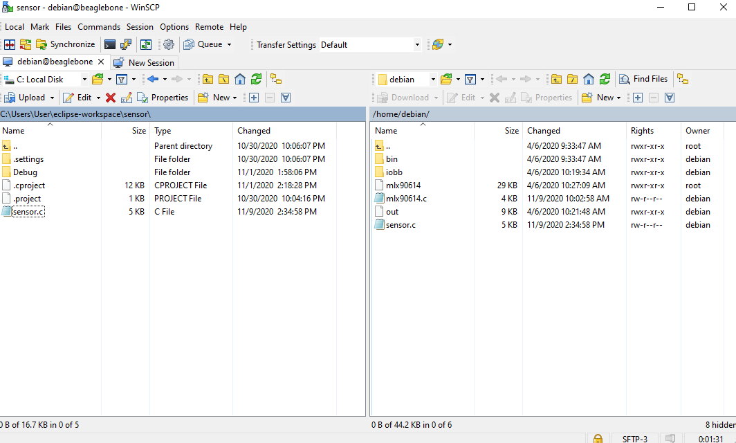

Slide 22
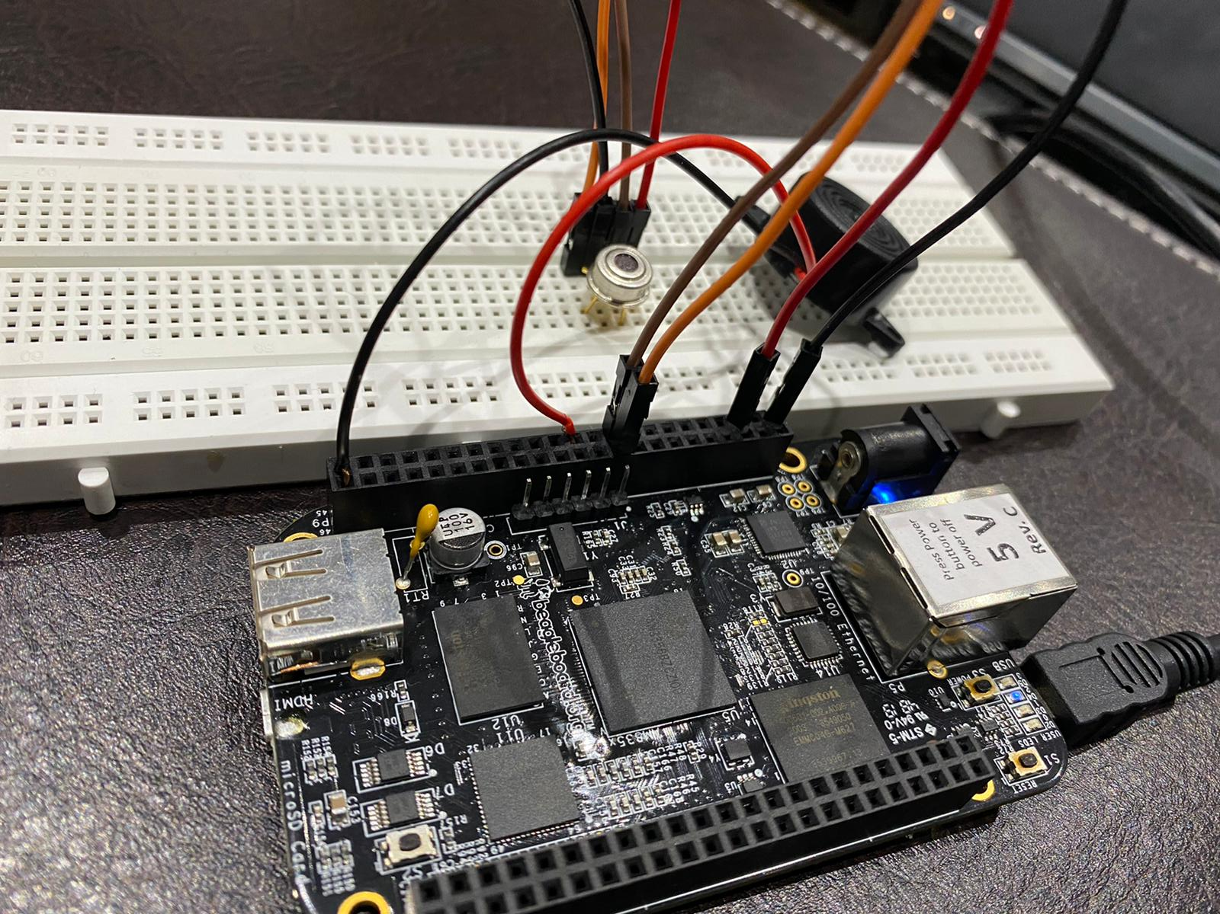

Slide 23
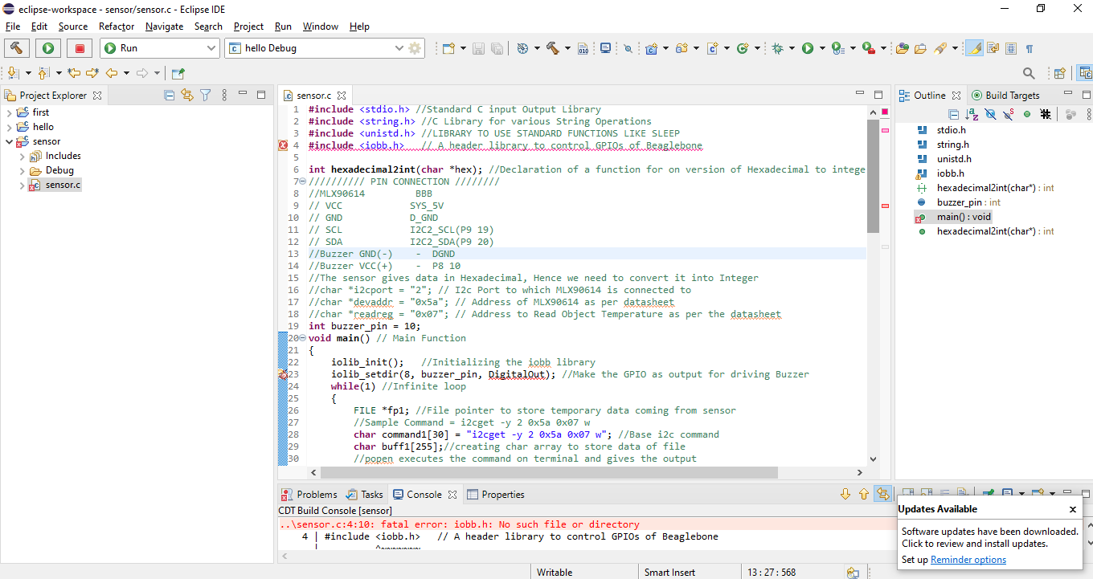
stdio.h defines the variable types and functions to perform the input/output operations
string.h is used for string operation
unistd.h is used from sleep function
Iobb.h is used to control GPIO pins of Beaglebone Black
Initially the pin for buzzer has been initialized and set it as a DigitalOut for driving a BuzzerLinux i2cget command is used for i2c operation.

Slide 24
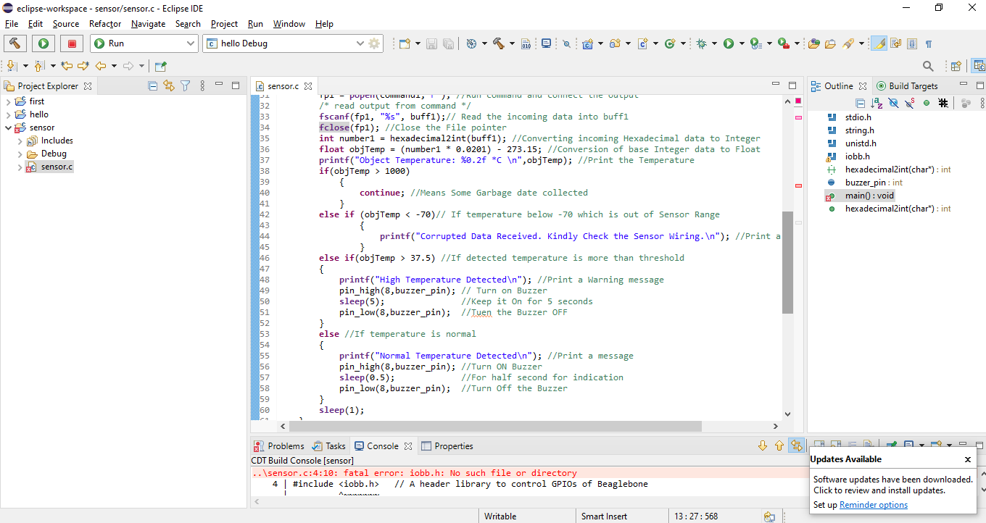
An array named as buff1 is created to store the data of file.
The output of sensor is in hexadecimal form so hexadecimal2int() function is used to convert it into integer form.
If the temperature is more than 37.5 C then the buzzer will turn on and it will ring for 5 seconds.
If the temperature is normal, then the buzzer in on only for half seconds to indicate that the temperature has been checked.

Slide 25
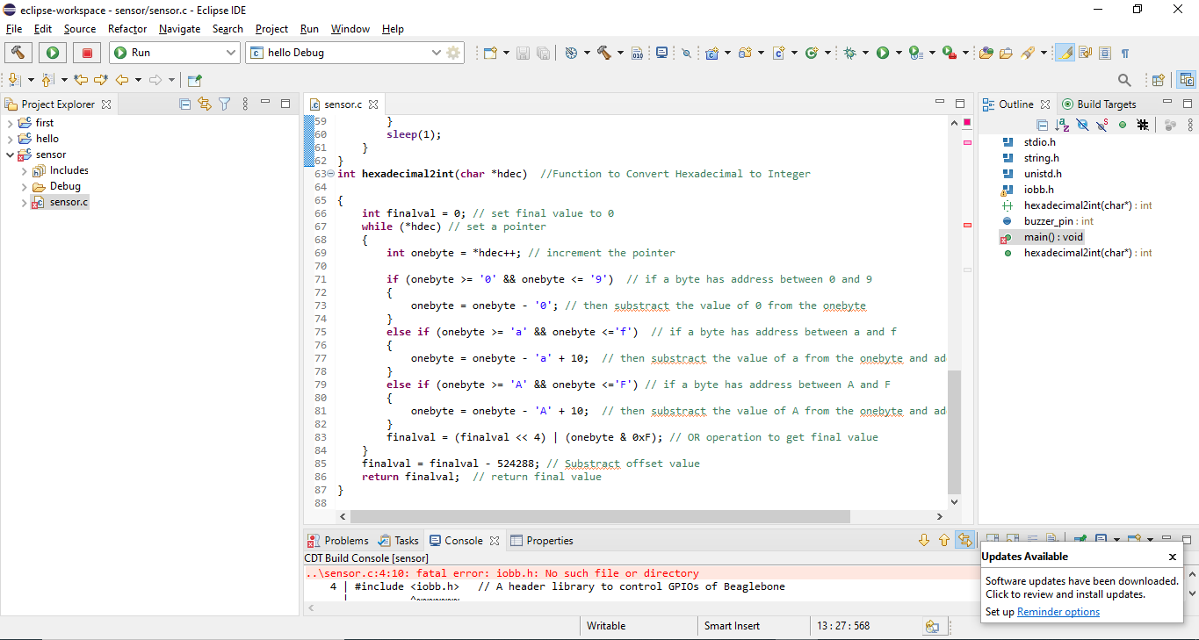
This a function to convert hexadecimal value to integer.
Here, if-else conditions are used to convert the values using ASCII table.

Slide 26
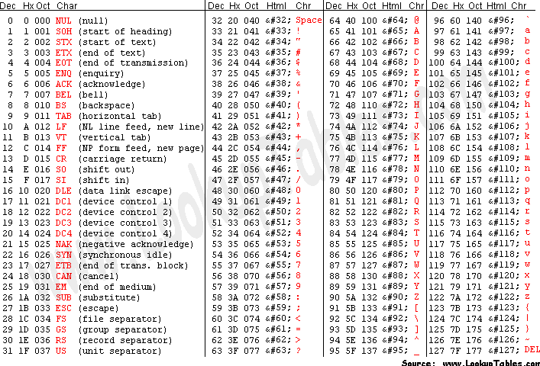

Slide 27
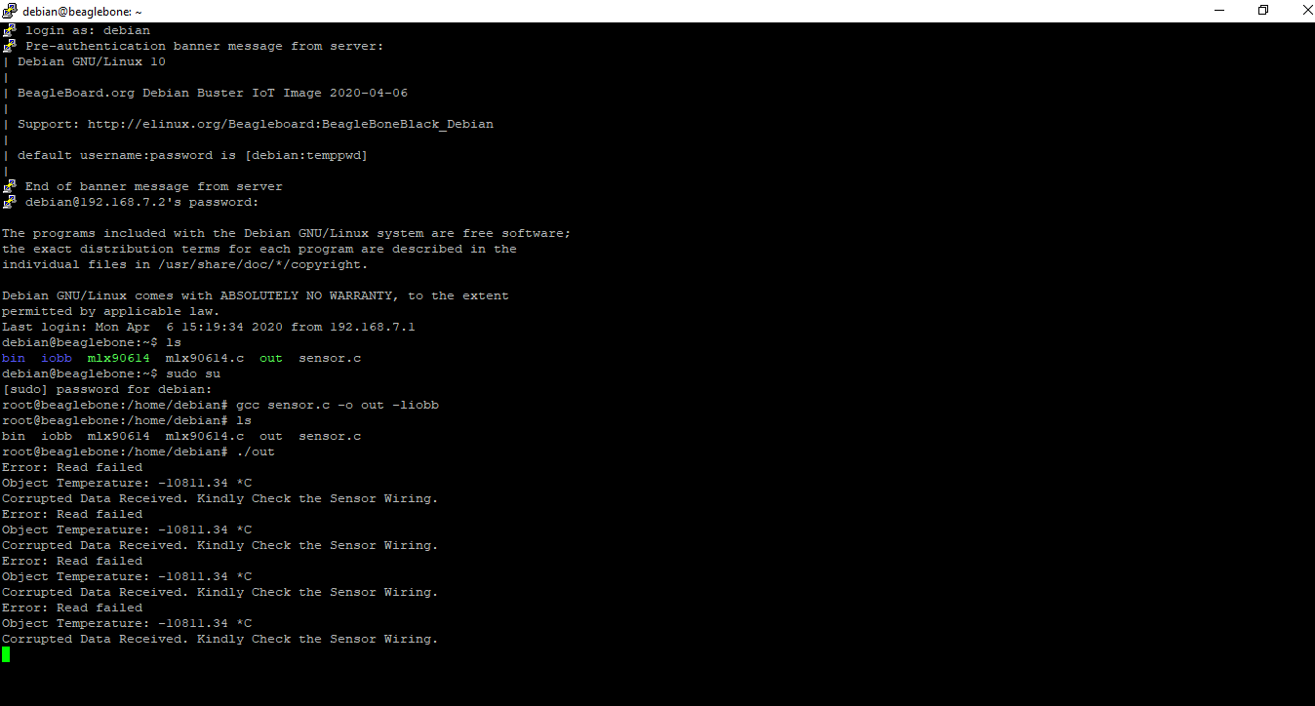

Slide 28
Conclusion
In this presentation, the main objective was to interface the temperature sensor and a buzzer to Beaglebone Black.
The sensor has been damaged while completing this interfacing and a new sensor has been ordered.
Once the component is received, then the results can be obtained.
It will be able to check the temperature of customer at the entrance. If the temperature is Ok, then there will be a small beep indicating that temperature has been checked.
If the temperature is high, then a buzzer will ring for 5 seconds.

Slide 29
References
shabaz. (2019, august 14). Beaglebone Black (BBB) and pocketbeagle I/O (GPIO), SPI, and I2C library for C - 2019 edition. element 14. Retrieved from : https://www.element14.com/community/community/designcenter/single-board-computers/next-genbeaglebone/blog/2019/08/15/beaglebone-black-bbb-io-gpio-spi-and-i2c-library-for-c-2019-edition
name, N. (n.d.). ASCII table and description. Retrieved from www.ASCIItable.com: http://www.asciitable.com/
name, N. (n.d.). ASCII table and description. Retrieved from www.ASCIItable.com: http://www.asciitable.com/
name, n. (n.d.). melexis mlx90614 datasheet. Retrieved from https://www.sparkfun.com/datasheets/Sensors/Temperature/MLX90614_rev001.pdf
name, n. (2018, January 9). I2C from the command line. Onion. Retrieved from : https://onion.io/2bt-digging-into-i2cget-and-i2cset/

Slide 30
References
Beagleboy. (2020, April 4). Beaglebone and MLX90614 infrared thermometer example in Python. Beaglebone.net. Retrieved from : https://www.beaglebone.net/code/python/beaglebone-and-mlx90614-infrared-thermometer-example-in-python.php
Campbell, S. (n.d.). Basics of I2C communication protocols. Circuit Basics. Retrieved from : https://www.circuitbasics.com/basics-of-the-i2c-communication-protocol/#:~:text=I2C%20is%20a%20serial%20communication,always%20controlled%20by%20the%20master.
Lara, M., & VK, V. (2020, july 22). Covert hex string (char[]) to int? stackoverflow. Retrieved from : https://stackoverflow.com/questions/10156409/convert-hex-string-char-to-int/25681839
PuTTY. (n.d.). Retrieved from Wikipedia, the free encyclopedia. Retrieved from: https://en.wikipedia.org/wiki/PuTTY
WinSCP Review and Download. (n.d.). Retrieved from ssh.com. Retrieved from: https://www.ssh.com/ssh/winscp/
https://github.com/shabaz123/iobb

Slide 31

Thank You

